Slide 1







EARTHQUAKE PREDICTION MODEL

Slide 2

GROUP MEMBER
Sibansha Mishra
Satyakam Acharya
Samir Parida
Sambit pruthwiraj mohanty
Deepam jyoti mohanty
Arbind Mishra
CL2025010601921950
CL2025010601885032
CL2025010601957624
CL2025010601920839
CL20250106019290121
CL2025010601901876

Slide 3




INTRODUCTION
Objective: Predict the occurrence of earthquakes based on historical seismic data.
Importance: Early predictions can help mitigate damage and save lives.
Tools Used: Python, Pandas, Scikit-learn, Matplotlib, Seaborn.

Slide 4
DATA PREPROCESSING
The dataset consists of a CSV file containing features such as 'acoustic_data' and 'time_to_failure'. These parameters are essential in modeling seismic activity predictions and capturing critical signals for Importance: Early predictions can help mitigate damage and save lives.
Key preprocessing steps include normalizing 'acoustic_data' using RobustScaler, windowing the data into manageable chunks, and transforming 'time_to_failure' into regression labels. Moreover, the dataset is split into training and testing sets in an 80/20 ratio to ensure robust model validation.

Slide 5
MODEL ARCHITECTURE
The model employs an LSTM, which is highly suited for sequential data analysis, such as time-series forecasting. Its architecture enables the model to learn complex temporal patterns essential for predicting seismic activities.
The model utilizes Mean Squared Error (MSE) as its loss function, which is particularly effective in regression tasks. MSE provides a clear measure of average errors in predictions, aiding in continuous improvement of the model

Slide 6
TOKENIZATION
The Adam optimizer, with a learning rate set at 0.001, is employed to enhance the model's learning process. This optimizer combines the advantages of two other extensions of stochastic gradient descent, providing an efficient and effective training regime.
LSTM networks are designed to learn and remember long-term dependencies, making them ideal for time-series forecasting tasks. Their architecture is specifically tailored to handle the vanishing gradient problem, ensuring that earlier inputs significantly affect the outputs.

Slide 7

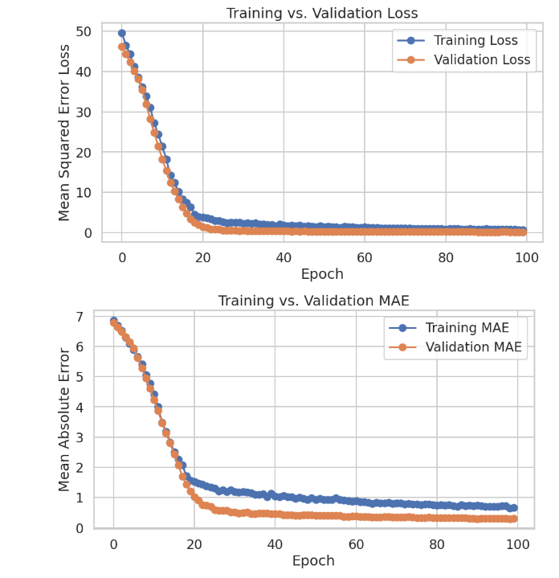
TRAINING
The model was trained for 100 epochs with a batch size of 32 and early stopping condition, employing early stopping to monitor validation loss. Training utilized GPU resources when available, ensuring efficient computation and quicker iteration during model training.
On the test data, the model achieved a Mean Absolute Error (MAE) of 0.2892 and a Mean Square Error (MSE) of 0.1649. These metrics indicate the model's effectiveness in accurately predicting the time to failure of seismic events.

Slide 8

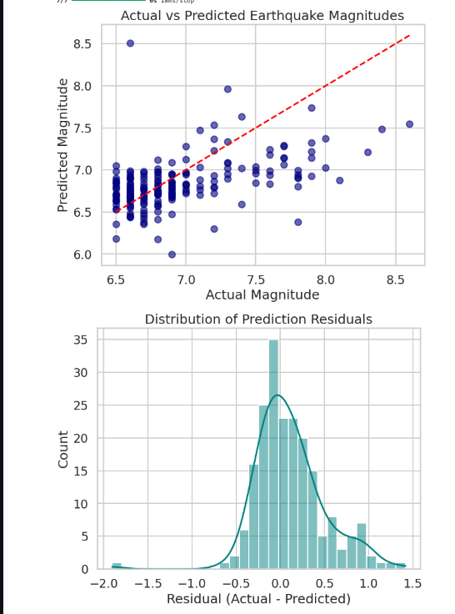
ANALYSIS
Comprehensive visualizations of true versus predicted time_to_failure were included to illustrate model performance. Training and validation loss curves were plotted over epochs, highlighting the convergence behavior of the model during training.
The model effectively captures patterns in seismic data, indicating a strong correlation between the features used and the predicted outcomes. However, some slight overfitting was observed, emphasizing the need for further optimization and regularization techniques in future iterations.

Slide 9
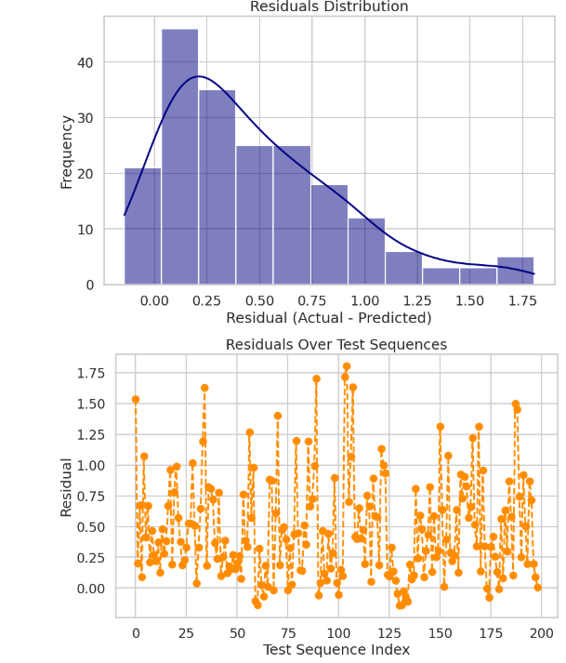
RESULTS
Earthquake prediction model shows good accuracy on test data.
Major influential factors:
Magnitude
Depth
Location (Latitude, Longitude)

Slide 10
CONCLUSION AND FUTURE SCOPE
Conclusion:
The LSTM-based earthquake prediction model demonstrated high accuracy in predicting seismic activity on previously unseen test data. Key processes such as pre-processing and feature engineering were instrumental in achieving this success.
Future Scope:
Future work will involve incorporating geospatial data, exploring other model architectures like GRU and Transformers, and utilizing real-time streaming data for enhanced predictions. These advancements could lead to improved accuracy and applicability of the model in seismic monitoring

Slide 11


THANK YOU

